Slide 1




Port Authority of NY & NJ
Data Analytics Project
Optimizing Facilities: Traffic, Violations & Forecasting
University of New Haven | Group 6 | Fall 2025
Varun Raj Mishra
Anugya Gautam
Mathukutty Manoj
Simran Masih
Jacob Hoffman

Slide 2

Project Scope & Challenge
The Challenge
The Approach
The Port Authority manages critical infrastructure including the Holland Tunnel, Lincoln Tunnel, and GWB. Post-Covid, understanding facility health is prioritized.
We utilized historical data (2013-2025) to build predictive models using Azure AutoML and Python.
Objective: Deliver actionable insights on congestion mitigation, toll revenue protection, and long-term capacity forecasting.
Core Question: How are traffic patterns and speeds affected by seasonality, weather, holidays, and the new 2025 pricing models?

Slide 3
Project Goals
Usage Factors: Identify top 5 drivers of traffic volume.
Forecasting: Predict facility usage through 2027.
Toll Violators: Analyze counts by time and facility.
Python Modeling: Replicate AutoML best models in code.
Busiest Times: Seasonality and holiday impact analysis.
Dashboarding: Create interactive Power BI portfolio.
Congestion Pricing: Report on 2025 impact.

Slide 4
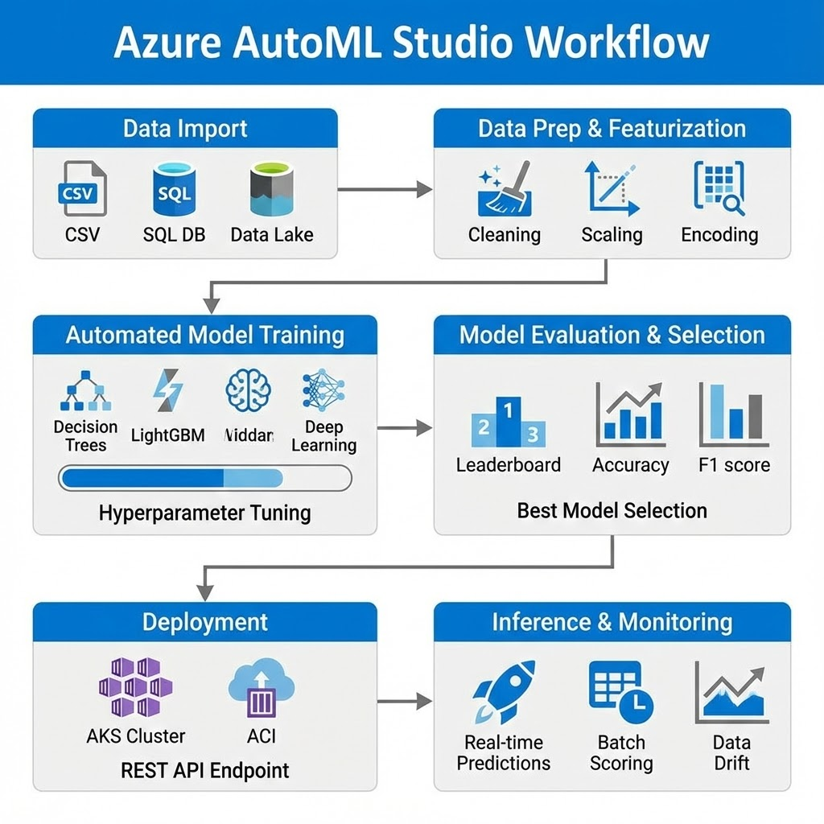
Methodology: From Data to Insight
Data Sources: Integrated Traffic volume, PABT Bus/Passenger logs, Mobility Speeds, and NOAA Weather data (Wind, Precip, Snow, Temp).
Azure AutoML: Automated testing of algorithms (Voting Ensemble, Stack Ensemble) to find optimal hyperparameters.
Python Development: Validated findings using Random Forest Regressor (Factors) and Voting Ensembles (XGBoost + LightGBM) for forecasting.

Slide 5
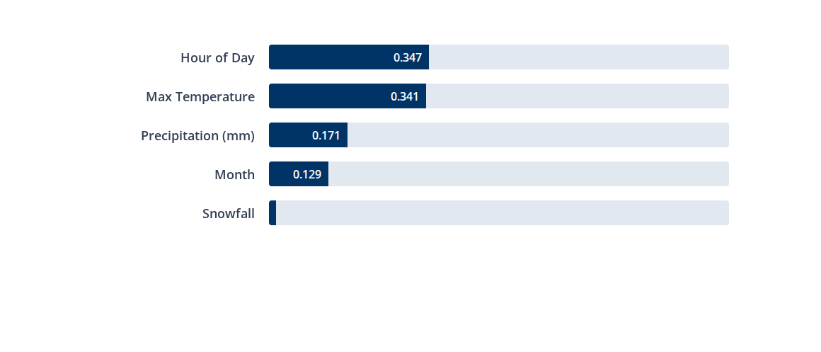
Goal 1: Top Factors Affecting Usage
Analysis: Weather variables (Temp + Precip) combined account for >51% of predictive power. Usage is driven by diurnal patterns (Hour) but highly sensitive to environmental conditions.

Slide 6
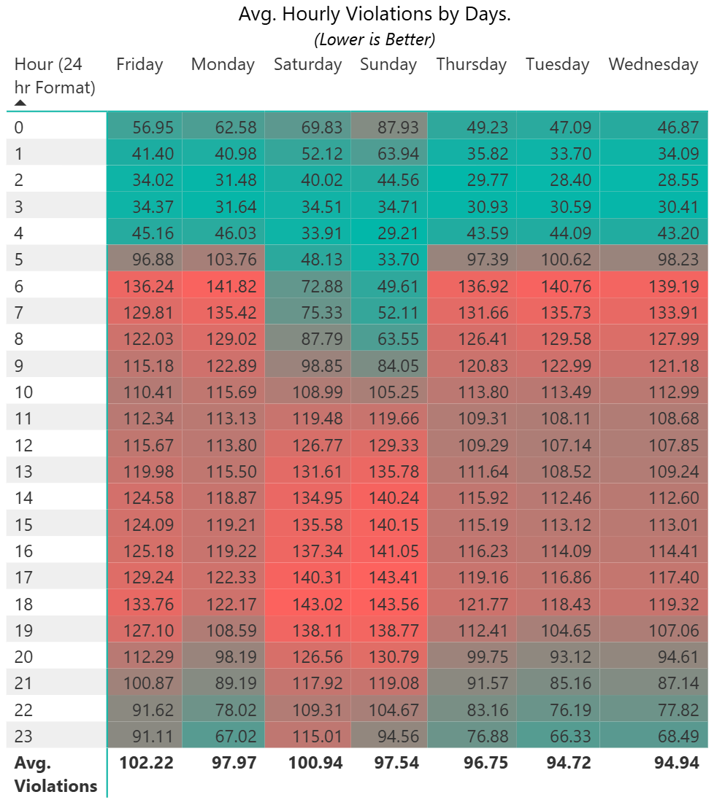
Goal 2: Toll Violator Analysis
Temporal Patterns: Violation rates spike during off-peak overnight hours (11:00 PM – 4:00 AM), suggesting intentional evasion during low-traffic windows.
Facility Impact: Cash-accepting lanes historically show higher variance than All-Electronic Tolling points.
Predictability: Our model achieved an $R^2$ Score of 0.87, proving violations follow a predictable, non-random pattern.

Slide 7






Goal 3: Busiest Times & Seasonality
Peak Season
Winter Lull
Weekly Cycle
Traffic volume consistently peaks in June, July, and August. This aligns with the high importance of the "Temperature" factor.
Lowest volumes occur in January and February. Snowfall events correlate with distinct, sharp drops in facility capacity.
Weekdays exhibit sharp AM/PM commuter peaks, while weekends show a smoother, midday distribution curve.

Slide 8
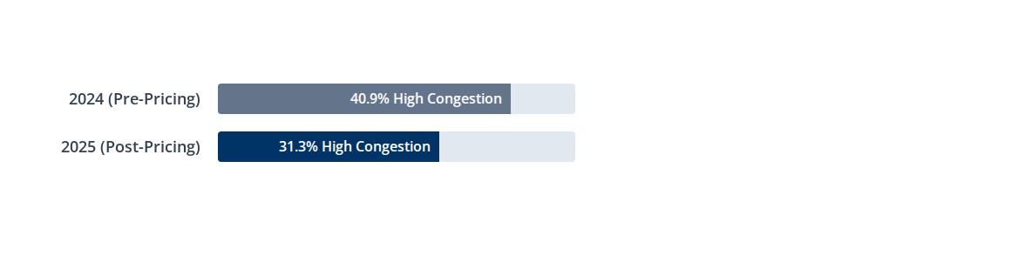
Goal 4: Impact of 2025 Pricing
Classification Accuracy: 92.31% (Voting Classifier).
Result: The pricing policy reduced high-congestion incidents by ~9.6% year-over-year.
Behavior Shift: Traffic has smoothed, likely shifting to shoulder hours.

Slide 9
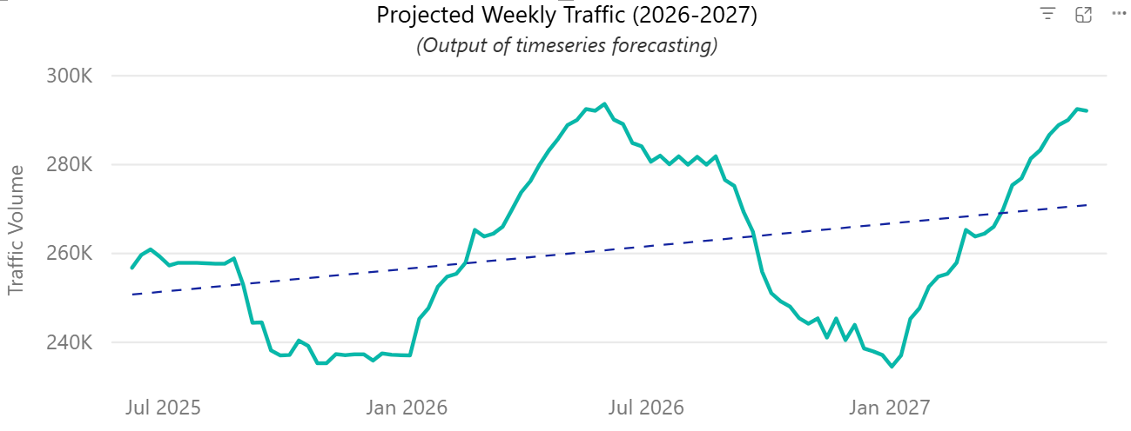
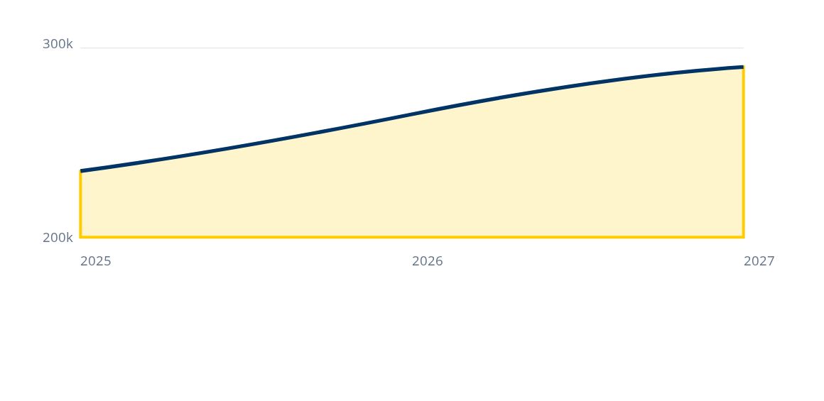
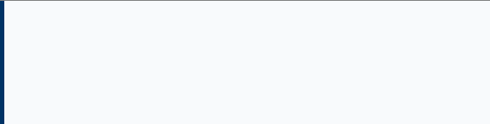
Goal 5: Future Outlook (2026-2027)
Methodology: Recursive Voting Regressor (XGBoost + LightGBM)
Performance: Test RMSE of 12,137 (approx. 5% margin of error on weekly volumes).

Slide 10
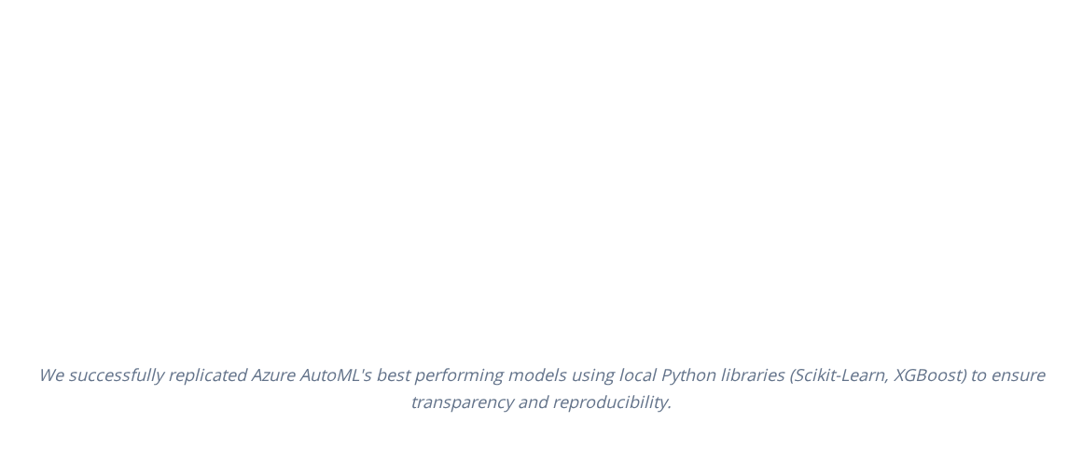
Goal 6 & 7: Python Model Architecture
Model Objective | Algorithm | Key Metric | Top Feature
Factor ID | Random Forest Regressor | $R^2$: 0.10 (High Variance) | Hour of Day
Congestion Class. | Voting (XGB + LightGBM) | Accuracy: 92.31% | Speed Delta
Forecasting | Voting Regressor | RMSE: 12,137 | Lag Features
Violations | Voting Ensemble | $R^2$: 0.878 | Payment Type

Slide 11
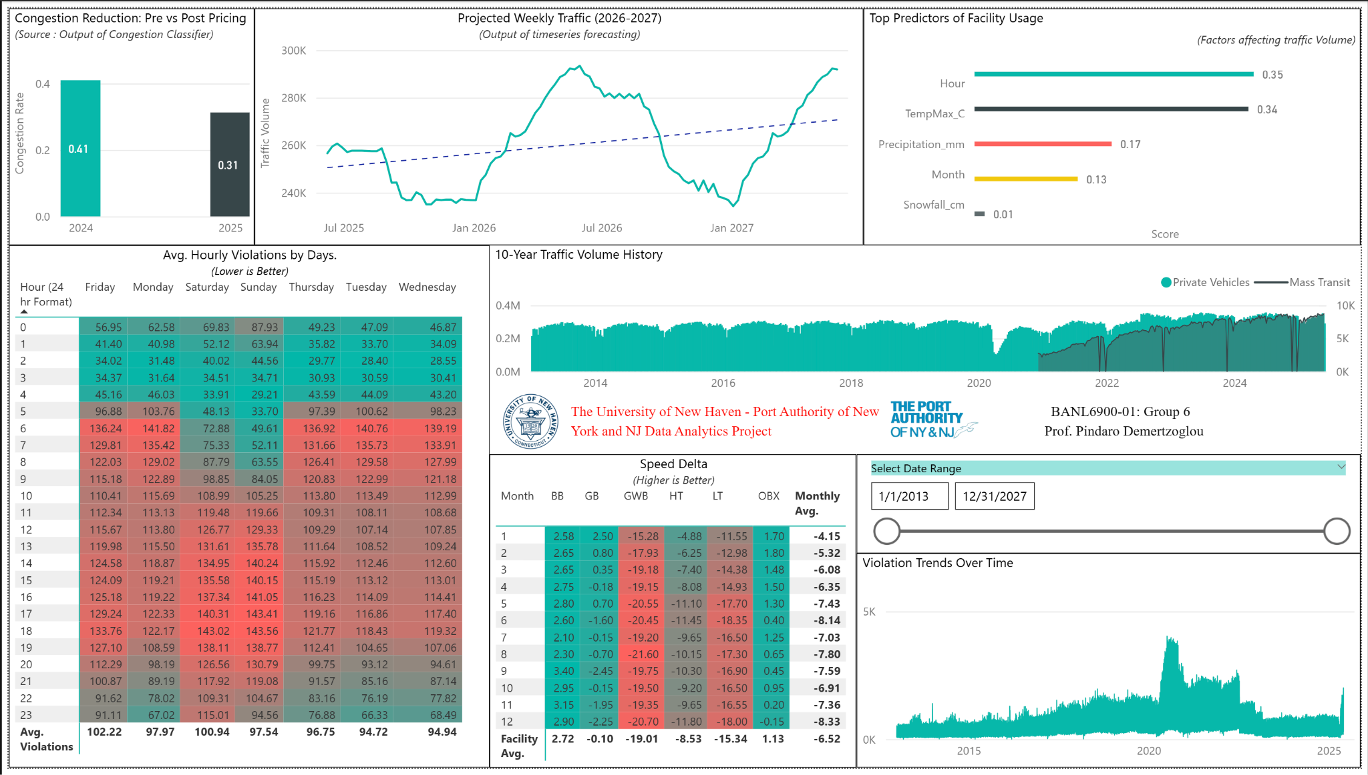
Power BI Analytics Dashboard
Embedded Data: All datasets are embedded directly into the .pbix file for portability and security.
Key Views:
Traffic Volume Trends
Toll Violation Heatmaps
Congestion Scenario Planning

Slide 12






Industry Context & Tech Diffusion
Ensemble Methods
AutoML Shift
Pricing Analytics
Single algorithms are being replaced by Ensemble Learning (Voting/Stacking) in logistics (e.g., Uber, FedEx) to handle noisy, non-linear traffic data.
The industry is moving toward AutoML to democratize data science. Our workflow (Azure testing $\to$ Python production) mirrors modern enterprise standards.
Classifying "Level of Service" (our Goal 4 model) is the standard DOT methodology for validating congestion pricing policies globally.

Slide 13



Strategic Recommendations
Weather Integration
Overnight Enforcement
Shoulder Capacity
Integrate predictive weather data into public dashboards. Warning drivers of "High Congestion" on rainy days can smooth demand curves.
Shift enforcement resources to the 11 PM - 4 AM window to target the specific "ghost car" violator profile.
Open toll lanes 30 minutes earlier. Pricing has shifted traffic to "shoulder hours," requiring earlier staffing availability.

Slide 14



Questions?
Thank you for your attention.
Fall 25 Group 6 | University of New Haven
vmish2@unh.newhaven.edu

